Slide 1
Introduction to Java programming language
Department of Data Science
Faculty of information technology, Mutah university

Slide 2
Agenda
Outline:
Brief history of Java
Overview of Java features
Setting up the Java Development Kit (JDK)
Your first Java program
Basic syntax and structure

Slide 3
Brief History of Java
Developed by Sun Microsystems
Java was initially conceptualized by a group of engineers at Sun Microsystems, in the early 1990s.
It was originally designed for digital devices, like interactive television, but was too advanced for the cable television industry at that time. The team then shifted its focus to the web, which was growing rapidly.
Note: "Write Once, Run Anywhere"
Acquired by Oracle Corporation in 2010: The deal was finalized and completed in January 2010, with Oracle acquiring Sun for approximately $7.4 billion

Slide 4
Why Java?
Platform Independence:
Java programs are compiled into an intermediate form called bytecode rather than directly into machine code.
This bytecode is then interpreted or compiled at runtime by the Java Virtual Machine (JVM) on the target platform.
Object-Oriented Language: can write large scale applications easily
reusability
Robust and Secure:
automatic garbage collector
reduces the chances of corrupting memory accidentally
Rich Standard Library: supported and used by thousands of users and hundred of companies
Libraries for ML, image processing, Big data analysis, and many more.
Widely Used in Industry

Slide 5
Cont.
One might ask why java over C++?
java Just-In-Time (JIT) compilers can optimize performance during runtime
In C++ you need to optimize the code yourself
java does not have pointers
C++: Provides more direct access to memory through pointers, which can be both an advantage (in terms of performance and control) and a disadvantage (in terms of safety)
java gives automatic memory management
C++: Memory management is largely manual.
Java: The primary design goal of Java is "Write Once, Run Anywhere" (WORA)
C++: Code needs to be compiled for each specific platform it targets, which can make cross-platform development more challenging.

Slide 6
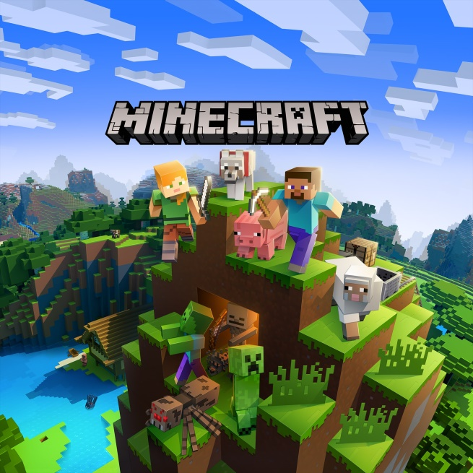
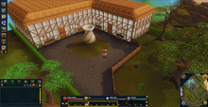



Applications uses java
Games:
Minecraft: a game developed using java
Runescape: Programmed in java then replaced with C++
Big data:
Twitter, Facebook and many big enterprises use java for database management, large data analysis
Spark was implemented in Scala which runs on jvm
Hadoop ecosystem itself is mostly built from Java
Mobile applications:
Spotify (Music Streaming App)
Twitter
Opera Mini (Web Browser)

Slide 7
Setting up JDK
What is JDK?
Java Development Kit
Essential for Java development
Contains all the functionalities you need to develop your java applications
If you want to run java applications, Java Runtime Environment (JRE) would be sufficient
Installation steps:
Download JDK from Oracle's website
Install JDK
Set environment variables (if necessary)
Follows more details

Slide 8
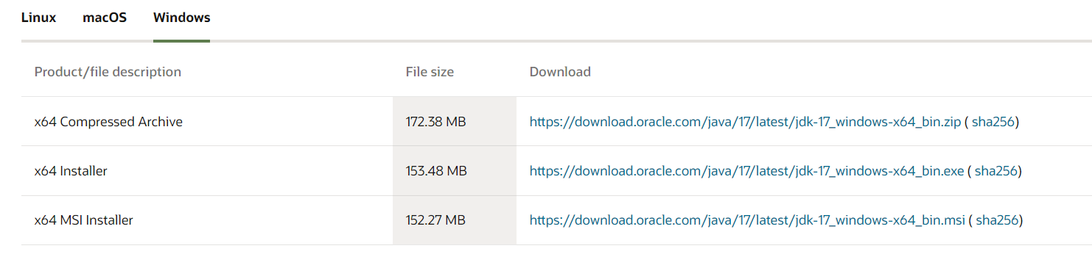
JDK installation
Visit this link:
https://www.oracle.com/java/technologies/downloads/#jdk17-windows

Slide 9
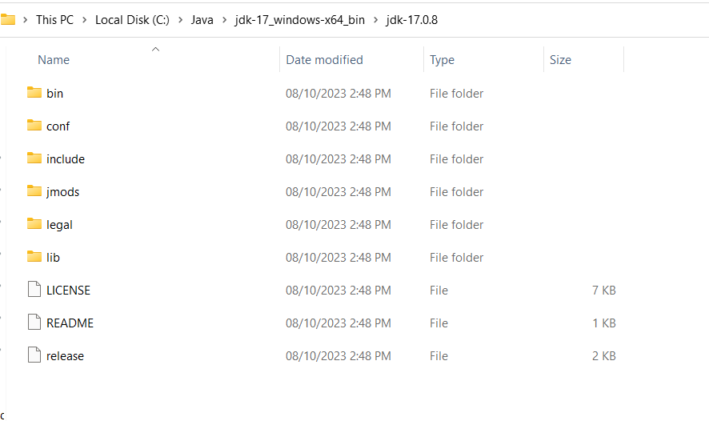
Cont.

Slide 10
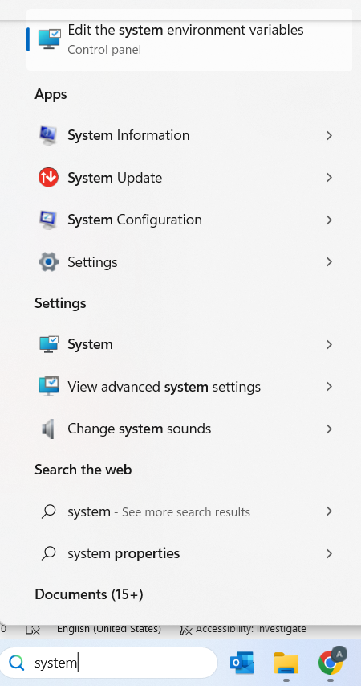
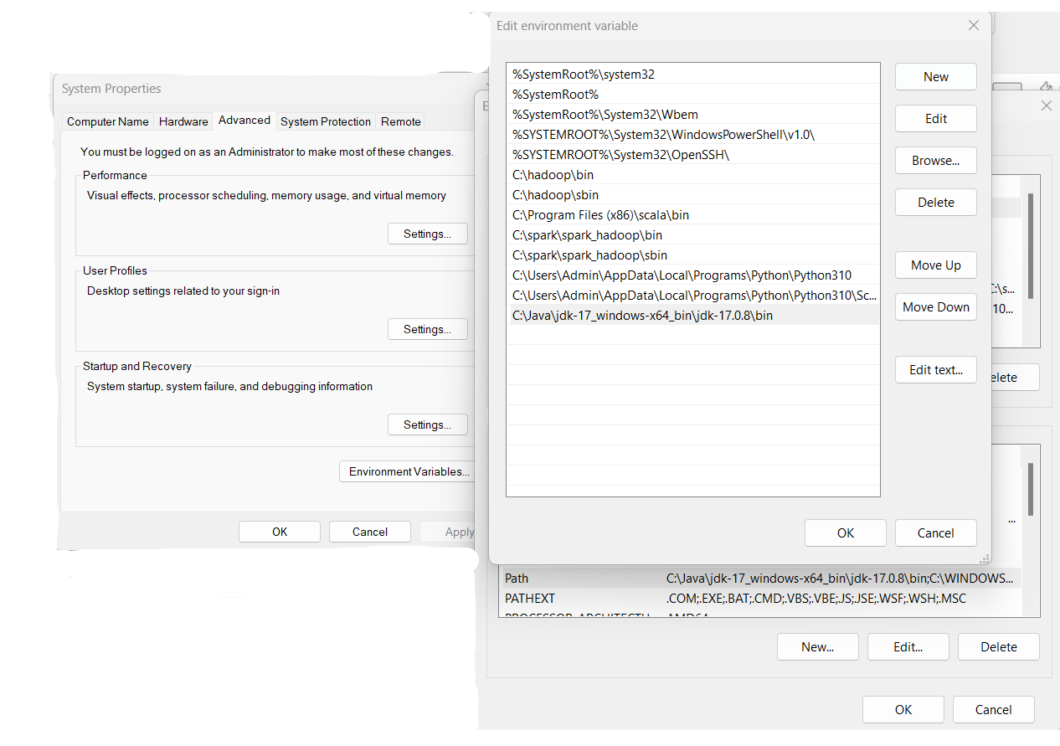
Edit system variables

Slide 11
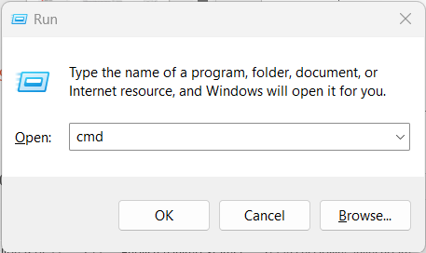
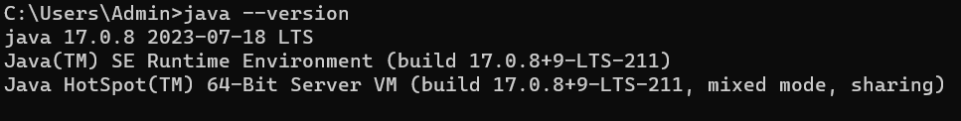
Check the installation
Ctrl + R then type cmd to open the command prompt
Type java –version in the active line then Enter, you should see the version

Slide 12
IntelliJ IDE
IDE stands for "Integrated Development Environment."
An IDE is a software application that provides a comprehensive set of tools for programmers to develop software. These tools often include:
A source code editor for writing and editing code.
A compiler or interpreter to translate the source code into machine code or bytecode.
Debugging tools to identify and fix errors in the code.
Popular IDEs for Java development include Eclipse, IntelliJ IDE, and NetBeans.
In this course we will use IntelliJ IDE.
Follows are the installation steps

Slide 13
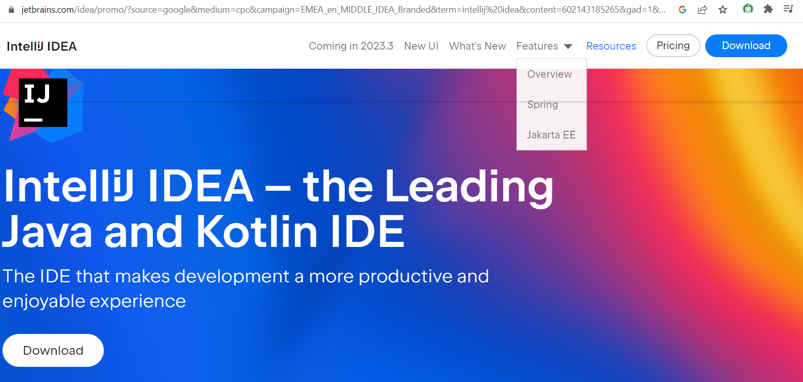
IntelliJ IED installation
Click the Download button and it will start automatically.
proceed with the installation and run the app normally
Visit this link: Download link

Slide 14
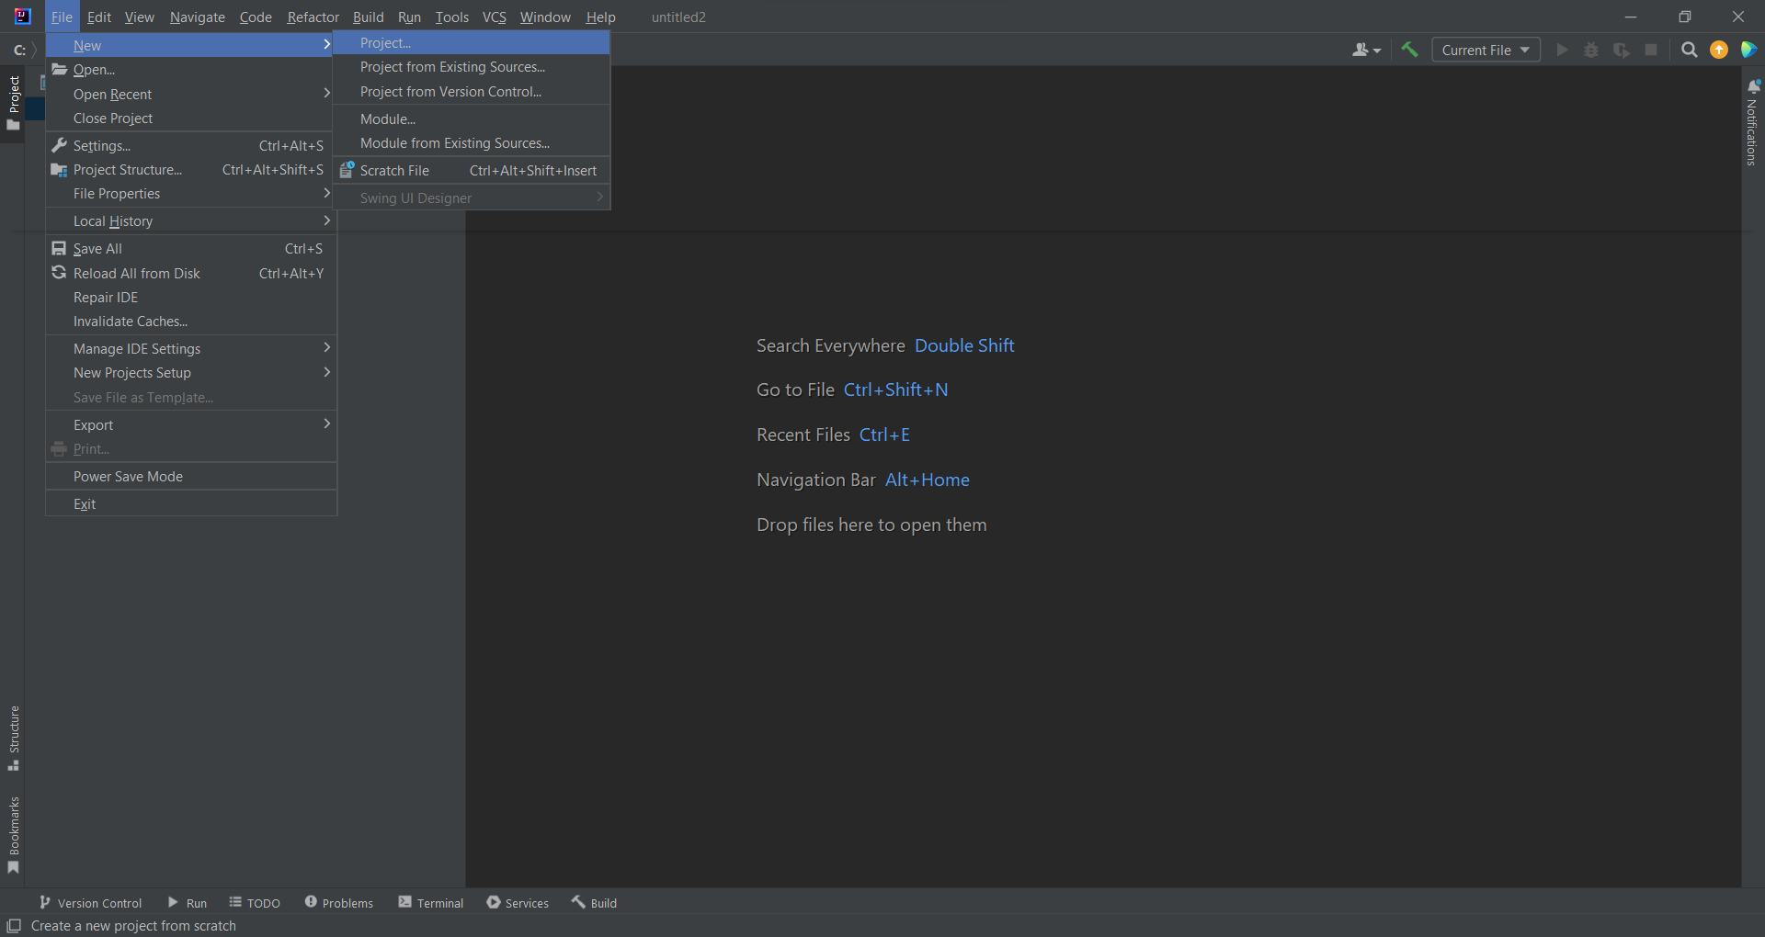
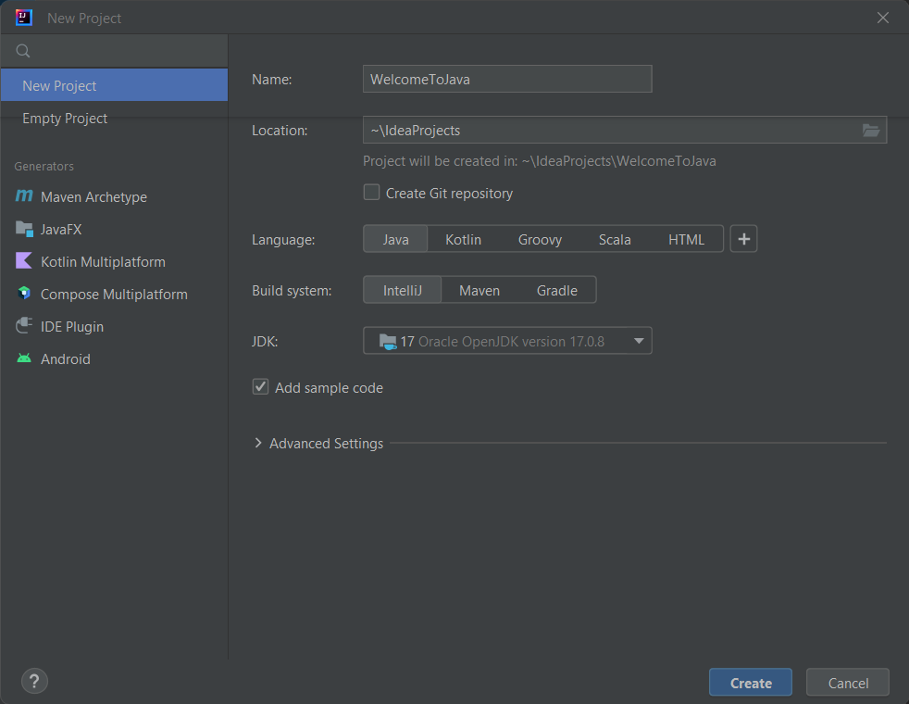
Run your first Program
Open the IDE and create a new java project as follows

Slide 15
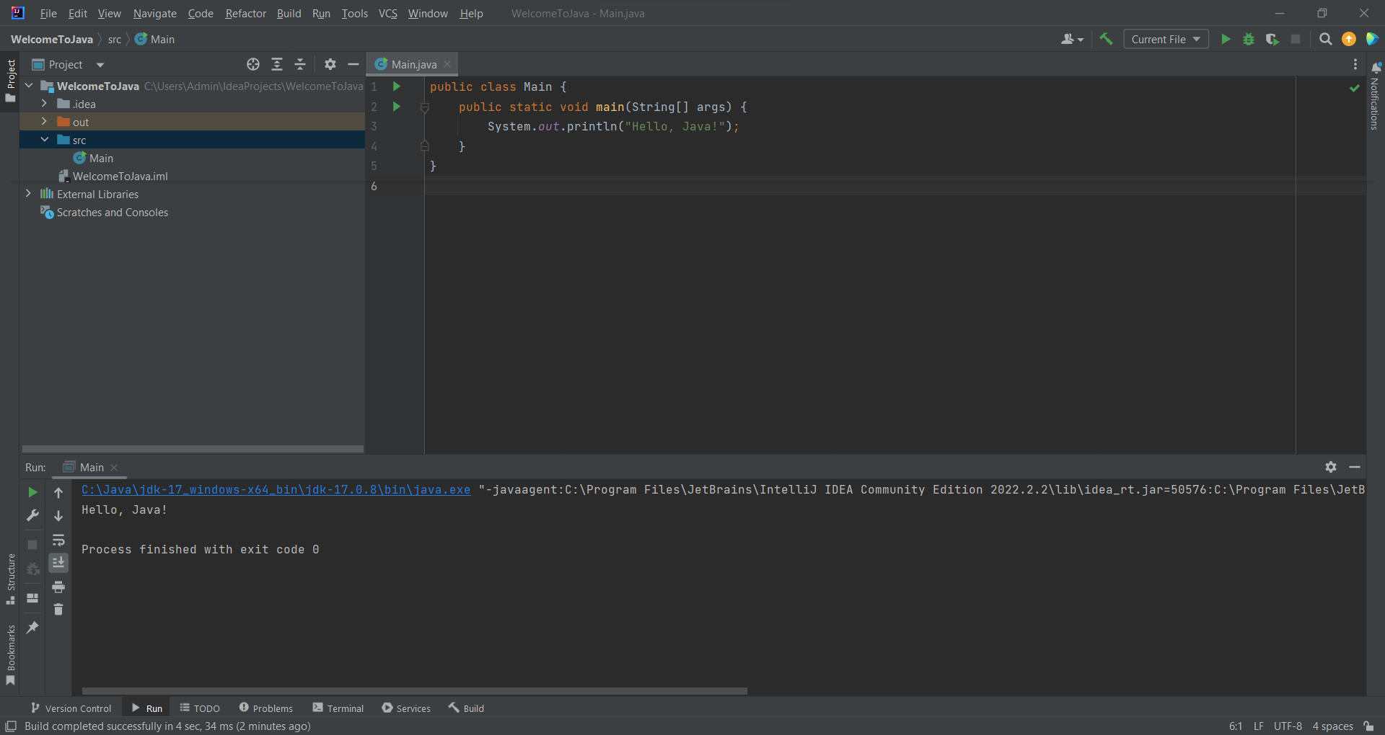
Your first program
public class HelloWorld {
public static void main(String[] args) {
System.out.println("Hello, Java!");
}
}

Slide 16
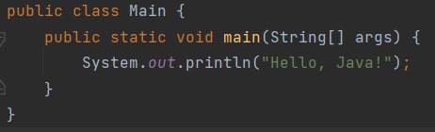
Explanation
public: This is an access modifier. It means that the Main class can be accessed from any other class in any package.
class: This keyword is used to declare a class in Java.
Main: This is the name of the class. By convention, class names in Java start with an uppercase letter.
static: This means that the main method belongs to the class and not to any specific instance of the class. It can be called without creating an instance of the Main class.
void: This is the return type of the method. void means that the method does not return any value.
main: This is the name of the method. The main method is a special method in Java—it's the entry point of the application.
When you run a Java application, the JVM (Java Virtual Machine) starts executing from the main method.
String[] args: This is the parameter to the main method. It's an array of String values that you can pass from the command line when you run the program.

Slide 17
Basic Syntax
Case Sensitivity: Java is case-sensitive.
Class Names: Start with an uppercase letter.
Method Names: Start with a lowercase letter.
File Name: Should match the class name.

